Slide 1
Ethical workgroups
Form your team

Slide 2
Announcements
Gathering literature on your project
Project management
Due dates
Coming week
For case reporting 5 marks quiz.
Google Scholar
Web of science
SDL
ACM
One slide reporting distribution of tasks among the members including
Designing the project code of conduct
Literature review
Benchmarks for similar cases
Distribution of analysis tasks

Slide 3
Professional ethics
Abdel monim Artoli
Reading: chapter 4 of the textbook

Slide 4
Objectives Contents
Identify and address ethical issues in the profession
What is a profession?
Describe mechanisms for ethical decision making
Being an ethical professional
Judge on professional codes
Professional and ethical responsibilities
Tutorial
Case studies
Requirements for a profession
Professional decision making

Slide 5
Motivating case study
A colleague of yours, named Beani owns a company in Riyadh Computer Complex in Ulaya. The company distributes a global security software which seems very expensive for individuals to buy. Recently, you have been a victim of many attempted and serious hacks. You contacted your colleague who reacted by providing you with a crack procedure for that software.
Report if there is any ethical issue within this action.
Justify, analyze and suggest solution for the issue.
Discuss implications if a successful attack on your system has occur.
Discuss pros and cons of alternative cheap and freeware solutions.

Slide 6
Are you one of those who
Download materials from the internet
Which type?
Is it in the public domain?
use downloaded material
plagiarism
piracy
Publish on www
Social media
Copyright violation
Documents
Document
software
Picture, …etc.
Freeware, shareware, licensed (site/single)
copyright
Similarity reports
privates
Opinions
Advertisements
Games
Channels
Harmful sites

Slide 7
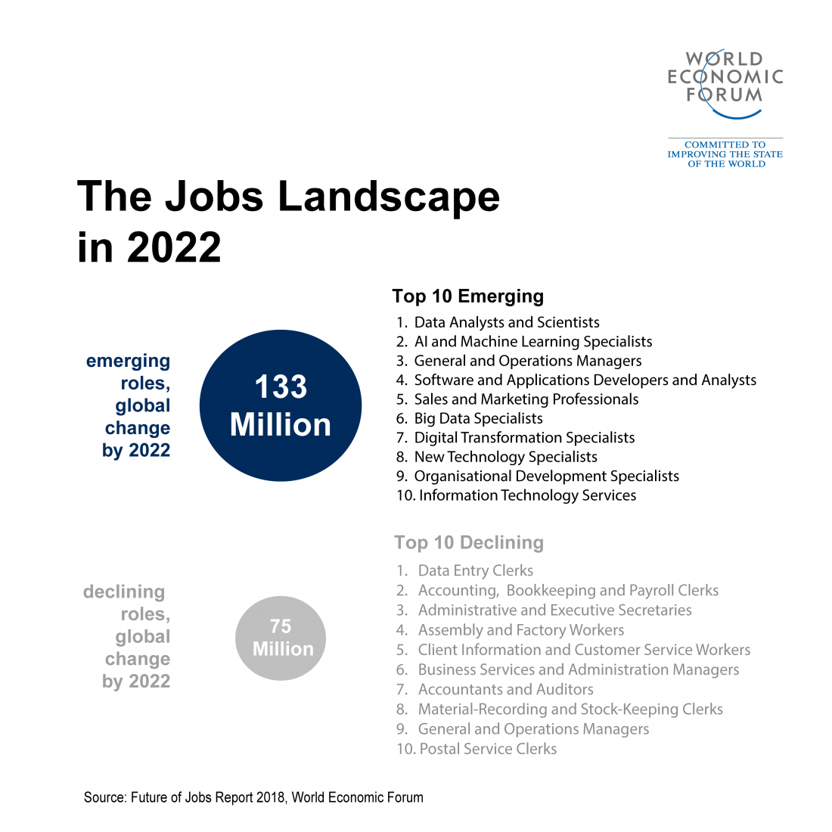
What is a profession?
Evolved from being professed
=To announce a public declaration
Webster dictionary:
a calling requiring specialized knowledge and often long and intensive academic preparation
a principal calling, vocation, or employment
the whole body of persons engaged in a calling

Slide 8
Framework
Requirements
High Skills and deep knowledge of the domain
Autonomy in provider-client relationship
Observance of 4 codes of conduct:
Professional Code
Personal code
Institutional code
Community code
Supports
Commitment
will
Do your best
What, who and when
Open and public
negociate
advance notice
Integrity
Vision
Love
commitment
Responsibility
Roles
Tasks
Actions
Product, service and sequential
Accountability
Measurable outcomes
Performance standards
Conseqnt Incentives and penalties
Deliverables:
Service
product
Professional code
Personal code
Institutional code
Community code

Slide 9
Making an ethical professional
Formal Education
Targeted and incremental
Proper use, no harm, formal courses, direct penalties, etc.
Licensing
Universities and state
Professional organizations
Professional codes of conduct
To create and maintain public good image about the profession
Address: Moral and legal standards, Professional–client relationship , Client advocacy, Professional–public relationships , Sanction mechanics, Confidentiality Assessment, Compliance , competence
Means of enforcement, reporting, hearing, sanctions, appeals
4. Dilemmas in Professional decision making
Mapping input premises with values to an output.
F(premises( values) = D
E.g. Shall I walk to a mall or take a car?
Premises: time, cost, gas, parking, etc.
Values? Save time, need parking, etc
Conflicts
Changing technology
Incomplete or misleading information

Slide 10
Avoiding guilt
Identify and examine ethically relevant issues
Determine affected parties and their interests
Decide course of action alternatives
Consider probable consequences
Consult
Evaluate values, bias, self interest, etc
Be prepared
Assume responsibility
Reconsider
evaluate
Professionalism and Ethical Responsibilities
Whistle-blowing
Harassment and discrimination
Ethical and moral implications

Slide 11
Further readings
Chapter 4 of the book
Ethical and social issues in the information age, 5th edition by J. Kizza
IEEE code of ethics
Saudi codes of ethics
Aramco
Sabic
Telecommunication
Banks
Al-Elm
STC
National telecommunication
Communications and Information Technology commission

Slide 12
Questions
Define professionalism
List two elements of professionalism
Discuss the benefits of licensing in software trade
Describe how ethical decisions are made
Before whistle-blowing, what would you do to minimize the consequent risk.
Compare between codes of professional ethics for two Saudi organizations from your p.o.v. to help you before applying for a job.

